Slide 1
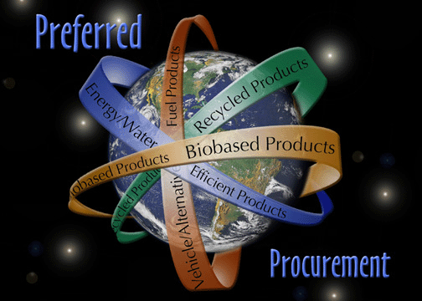
Sustainable Acquisition
Fermilab’s SA Program

Slide 2
Outline
What is Sustainable Acquisition?
Requirements
Responsibilities
Types of SA products
Exceptions
Resources
SA Issues
SA’s Future

Slide 3
What is SA?
Sustainable Acquisition is the acquisition of products or services that have a lesser or reduced effect on human health and the environment when compared with competing products or services that serve the same purpose.
Notes:
Sustainable Acquisition (or SA) is the acquisition of products or services that have a lesser or reduced effect on human health and the environment when compared with competing products or services that serve the same purpose.

Slide 4
Why Buy SA?
The Federal Government purchases more than $200 billion worth of products and services each year.
Purchasing environmentally preferable products or services will do one or more of the following:
  Minimize the consumption of resources, energy and water
  Prevent the creation of solid waste, air pollution or water pollution
  Minimize or eliminate the use of materials or processes which compromise the environment (global warming, ozone depletion and acid rain)
  Promote the use of non-toxic substances and avoid toxic materials or processes
Notes:
People often ask, why do we have to by SA? The Federal government buys more than $200 billion worth of products and services each year. So it has a powerful lever to shift the market toward sustainable products. Buying SA can minimize resource consumption like energy and water; it can prevent the creation of waste and air and water pollution; it can minimize or even eliminate the use of materials and processes that contribute to climate change, acid rain and ozone depletion. And it also promotes employee health through the use of non or less-toxic materials.

Slide 5
Why Use SA?
Recycled aluminum cans require 95% less energy to manufacture.
Using 1 ton of recycled paper saves 20 trees and 7,000 gallons of water.
100 Energy Star computers and monitors can save $10,000 in energy costs over 5 years.
Correlation between improved health and working environment when using certain SA products.
Notes:
These are a few statistics that support purchasing SA:
Recycled aluminum cans require 95% less energy to manufacture.
Using 1 ton of recycled paper can save 20 trees and 7,000 gallons of water.
Using 100 Energy Star computers and monitors can save $10,000 in energy costs over 5 years.
Also, there is a correlation between improved health and the working environment when using certain SA products.

Slide 6
Requirements
E.O. 13514
  Federal Leadership in Environmental, Energy, and Economic Performance
Notes:
The SA program was promulgated through a series of Executive Orders; the most current Executive Order is EO 13514, which requires federal agencies to show leadership in environmental performance.

Slide 7
Contract Requirements
E.O. 13514 requires Federal facilities to
  Ensure 95% of new contract actions, task orders, and delivery orders for products and services (excluding weapon systems) are energy efficient (ENERGY STAR® or FEMP-designated), water efficient, bio-based, environmentally preferable (Electronic Product Environmental Assessment Tool (EPEAT) certified), non-ozone depleting, contain recycled content, or are non-toxic or less-toxic alternatives where such products and services meet agency performance requirements.
Notes:
Under this executive order, all federal agencies must reduce their greenhouse gas emissions, integrate sustainable building design into all new construction, reduce water consumption, continue with pollution prevention and waste reduction efforts, and ensure that 95% or greater of all new contract actions, task orders and delivery orders for products and services are environmentally preferable, where such products and services meet agency performance requirements.

Slide 8
FESHM 5011
Fermilab’s Sustainable Acquisition Program
  This chapter provides information and resources for employees to specify SA products and services in Fermilab contracts. In addition, the chapter describes how all purchases, even those outside of contracts, shall show preference to SA items if there is a SA item that meets the requirements of the purchaser.
Notes:
We’ve recently published a new chapter to our ES&H Manual that defines our Sustainable Acquisition Program. It describes how employees must specify SA products and services in contracts, and buy SA anytime they purchase a product when it meets their requirements.

Slide 9
Responsibilities
Fermilab’s Business Services Procurement Group:
  Continue existing and forge new relationships with vendors that provide SA products and services.
Construction Coordinators/Task Managers/Service Coordinators:
  Ensure that the specifications of the contract are carried out by the subcontractor (i.e. ensure that specified SA items are used).
Notes:
Certain responsibilities are assigned to employees or groups within the lab and we define these in the FESHM chapter.
Business Services Procurement Department is responsible for continuing existing and forging new relationships with vendors that provide SA products and services.
Construction Coordinators, Task Managers and Service Coordinators will ensure that the specifications of contracts they oversee are carried out by the subcontractor (for example, ensure that specified SA items are used).

Slide 10
Responsibilities - Continued
Employees:
  Specify SA items in service and product contracts. In addition, purchase SA products any time a SA product is available and meets the purchaser’s requirements.
  Complete the SA training.
D/S/C Environmental Officers:
  Provide guidance for all employees regarding Sustainable Acquisition.
Notes:
Responsibilities continued…
All employees are responsible to specify SA in contracts, and buy SA anytime they purchase something. The must also complete a one-time training on SA.
Every Division and Section has an Environmental Officer. The EO is responsible to help implement SA within their organization.

Slide 11
Types of Products Available
Biobased products
Recycled content products
Alternative fuels/vehicles
Energy/water efficient products
Non-ozone depleting products
Notes:
Types of SA products available include:
Biobased
Recycled content
Alternative fuels/vehicles
Energy/water efficient
Non-ozone depleting

Slide 12

Biobased Products
Biobased products are commercial or industrial products that are composed in whole, or in significant part, of biological products or renewable domestic agricultural materials or forestry materials.
Notes:
Slide 13
Biobased products are commercial or industrial products that are composed in whole, or in significant part, of biological products or renewable domestic agricultural materials or forestry materials.

Slide 13
Biobased Products
Biobased product categories include:
  Adhesives & sealants
  Construction materials—caulk, insulation, carpet, roofing sealant
  Fibers, papers & packaging
  Fuel additives
  Landscaping materials—compost and fertilizer
  Lubricants & functional fluids
  Paints & coatings
  Plant and vegetable inks
  Plastics—derived from renewable feedstocks
  Solvents & cleaners—products that meet the Green Seal standards
  Sorbents—peat moss, corn cobs, wool-based, cotton-based, etc.
Notes:
Slide 14
Biobased product categories include:
Adhesives & sealants
Construction materials— such as caulk, insulation, carpet, roofing sealant
Fibers, papers & packaging
Fuel additives
Landscaping materials—such as compost and fertilizer
Lubricants & functional fluids
Paints & coatings
Plant and vegetable inks
Plastics that are derived from renewable feedstocks
Solvents & cleaners—such as products that meet the Green Seal standards
And Sorbents—like peat moss, corn cobs, wool-based, cotton-based, etc.

Slide 14

Biobased Products - Examples
Construction materials can be made from residues of sugar cane, bamboo, corn, and soybeans.
Disposable cutlery and take-out containers can be made from cornstarch, potato starch, wheat and sugar cane.
Cleaning chemicals can be made with citrus rinds.
Clothing, such as socks and t-shirts, can be made from a biopolymer fabric spun from converted corn sugar.
Notes:
Slide 15
Additional examples of biobased products include:
Construction materials can be made from residues of sugar cane, bamboo, corn, and soybeans.
Disposable cutlery and take-out containers can be made from cornstarch, potato starch, wheat and sugar cane.
Cleaning chemicals can be made with citrus rinds.
Clothing, such as socks and t-shirts, can be made from a biopolymer fabric spun from converted corn sugar.

Slide 15
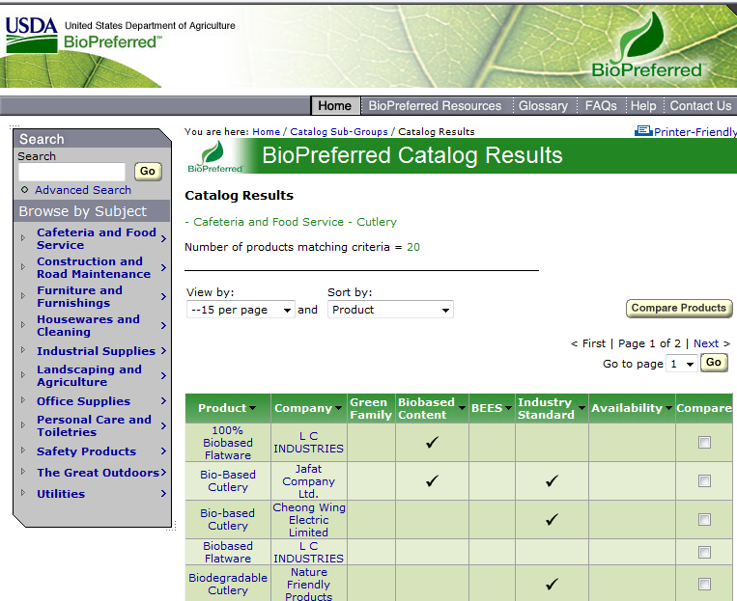
Notes:
The USDA’s BioPreferred Catalog can help you find biobased products from food service to electrical transformers.

Slide 16
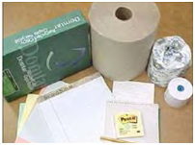
Recycled Content Products
Recycled products are materials that have been recovered or diverted from solid waste and have been utilized in place of raw or virgin material in manufacturing a product.
Notes:
Slide 16
Recycled content products are materials that have been recovered or diverted from the solid waste stream and have been utilized in place of raw or virgin material in manufacturing a product.

Slide 17
Recycled Content Products
Products containing recycled content include:
  Office supplies—paper, toner cartridges, folders, furniture, etc.
  Custodial supplies—tissue/towels, trash containers & bags, etc.
  Construction materials—carpet, cement, fiberboard, insulation, latex paint, etc.
  Landscaping materials—compost, edging, hoses, lumber, mulch, etc.
  Park & recreation products—benches, fencing, etc.
  Transportation products—barricades, cones, parking stops, etc.
  Vehicular products—coolants, oil, tires, etc.
  Miscellaneous—awards, drums, mats, sorbents, signs, etc.
Notes:
Slide 17
Products containing recycled content include:
Office supplies
Custodial supplies
Construction materials
Landscaping materials
Park & recreation products
Transportation products
Vehicular products
Miscellaneous products—like awards, drums, mats, sorbents and signs.

Slide 18
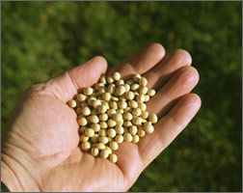
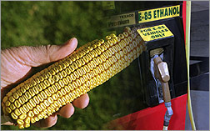
Alternative Fuels/Vehicles
Federal sites are required to purchase alternative-fuel vehicles, and operate dual-fueled vehicles on alternative fuel. Use of these fuels will reduce our dependence on foreign oil, and improve air quality.
Notes:
Slide 18
Alternative Fuels/Vehicles
Federal sites are required to purchase alternative-fuel vehicles, and operate dual-fueled vehicles on alternative fuels— such as biodiesel, ethanol, methanol and natural gas. Use of these fuels will reduce our dependence on foreign oil, and help improve air quality.

Slide 19
Alternative Fuels/Vehicles
Types of Alternative Fuels:
  Biodiesel
  Ethanol
  Hydrogen
  Natural gas
  Propane
Types of Alternative Vehicles:
  Flex-fuel
  Natural gas
  Propane
  Hybrid
  Plug-in hybrid
  Electric
  Fuel cell
  Diesel
Notes:
Slide 19
Some types of Alternative Fuels include
Biodiesel
Ethanol
And Natural gas
Some Alternative Vehicles are:
Flex-fuel
Hybrid
Electric
And Diesel

Slide 20


Energy-Efficient Products
Products such as lighting, appliances, office equipment, etc. all have energy-efficient options.
Federal sites are required to give preference to Energy Star qualified or FEMP (Federal Energy Management Program) designated products.
Need to reduce energy intensity 3% annually, 30% FY15 (baseline year FY2003)
Notes:
Slide 20
Energy-Efficiency refers to products that use less electricity than their non-efficient counterparts. Products such as lighting, appliances and office equipment all have energy-efficient options. Federal sites are required to give preference to Energy Star qualified or FEMP (Federal Energy Management Program) designated products.
This helps us to meet the energy intensity reduction goals required of all Federal sites.

Slide 21

Energy-Efficient Products
Computers and other electronics are assessed through EPEAT (Electronic Product Environmental Assessment Tool).
EPEAT reviews not only the energy efficiency, but also the product’s recyclable content, use of toxic metals, end of life management, etc.
Examples of a few criteria in EPEAT standards
  Restricts cadmium, hexavalent chromium, lead, mercury
  Specifies less material or post-consumer recycled or biobased plastic content
  Specifies design for longevity, reuse, take back including packaging
  Specifies Energy Star® certified equipment
Notes:
Computers and monitors, of course, are big energy hogs simply because there are so many in use every day. EPEAT designated computers and other electronics are not only the energy efficient, but they’re built with fewer toxic chemicals (cadmium, hexavalent chromium, lead and mercury), and are recyclable. EPEAT electronics are also built using less material overall or also with recycled or biobased content materials. They are also Energy Star certified.

Slide 22

Water-Efficient Products
Water-efficient products will be marked with the WaterSense symbol, indicating that the product meets EPA’s criteria for water efficiency. Water-efficient products include: faucets, toilets and urinals.
Federal agencies must reduce water use by 2% annually (using the FY2007 baseline)
Notes:
Water-efficient products will be marked with the WaterSense symbol, and are simply fixtures that use less water than their non-efficient counterparts. This basically includes bathroom fixtures such as toilets, faucets and showerheads. These products are easily identified by the WaterSense label. These products can help Federal agencies meet the water use reduction goals - 2% annually (using the FY2007 baseline).

Slide 23
Non-Ozone Depleting Products
Ozone depleting substances (ODS) are any substance on EPA’s Class I or Class II list of 40 CFR Part 82.
Notes:
Ozone depleting substances (ODS) are are known to negatively effect the stratospheric ozone layer. Federal facilities are prohibited from using ODS in new equipment, and in fact many ODS have been phased out of use in any equipment. . There are substitutes available for ozone-depleting products in the following categories:
Adhesives, coatings and inks
Aerosols
Cleaning solvents
Fire suppression & explosion protection products
Refrigeration & air conditioning

Slide 24

Non-Ozone Depleting Substances
There are substitutes available for ozone-depleting products in the following categories:
  Adhesives, coatings and inks
  Aerosols
  Cleaning solvents
  Fire suppression & explosion protection
  Refrigeration & air conditioning
Alternatives can be found under the EPA’s Significant New Alternatives Policy (SNAP) program.
Notes:
Slide 25
YOu can find alternatives to ODS for adhesives, coatings and inks, aerosols, cleaning solvetns, fire suppressino, and refrigeration and A/C.
EPA’s SNAP program can help you find those alternatives.

Slide 25
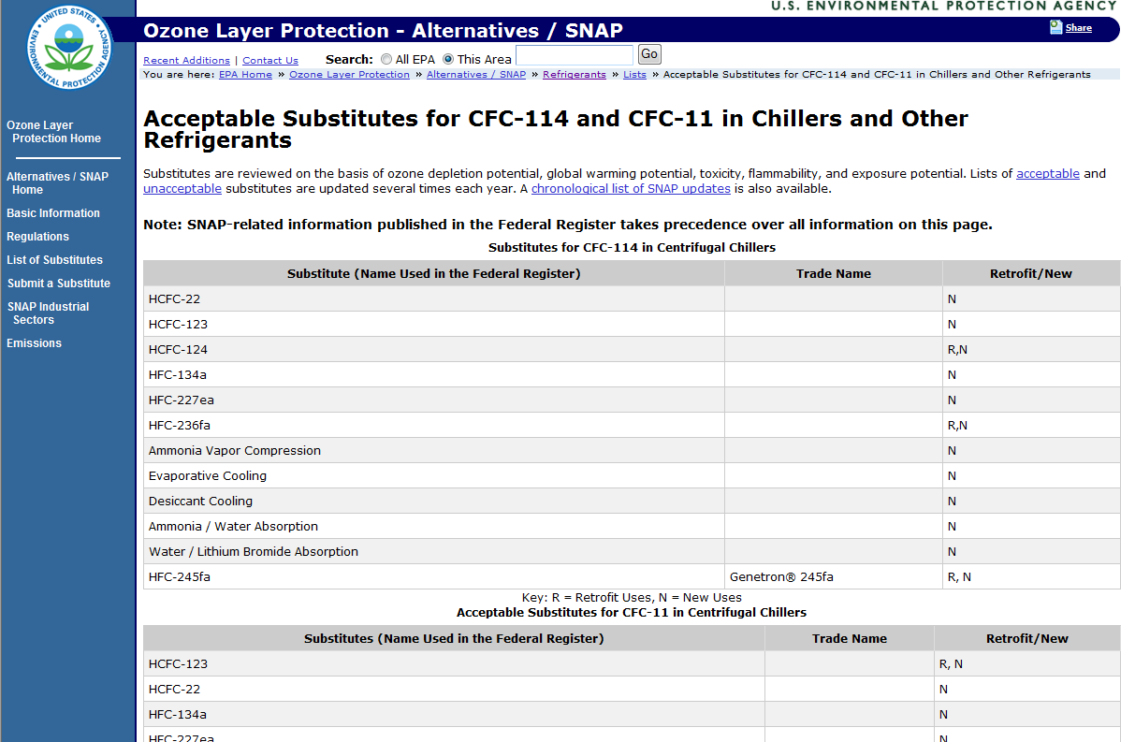

Slide 26
Use Life Cycle Analyses When selecting Green Products by Considering:
Raw materials (Is it a renewable resource?)
Manufacturing process (Is it energy/water efficient?)
Packaging (Is it returnable?)
Distribution/ transportation (Is it locally produced?)
Operation (Is it energy/water efficient?)
Maintenance (Is it healthy for staff?)
Special handling (Is it toxic?)
Disposal (Is it reusable or at least recyclable?
Notes:
We include this slide in the SA training in order to get employees to think about the entire life of the product they want to buy, from manufacturing to disposal. Employees should ask themselves…
Are the raw materials used to make the product from a renewable resource?
Is the manufacturing process energy and/or water efficient?
Is the packaging returnable?
Is the product locally distributed or produced?
Is the product itself energy and/or water efficient?
Is the product healthy for people to use or work on?
Or Is there a toxic component that requires special handling?
And when its useful life is over, can it be reused another way or recycled?
Is the product reusable or recyclable?

Slide 27
Exceptions
Fermilab employees must purchase designated SA products unless the product:
  Is not life cycle cost effective or exceeds 110% of the price of the non-sustainable item.
  Will not meet reasonable performance standards
  Is unavailable within a reasonable timeframe at a sufficient level of competition
However, there are NO exceptions for paper
  Fermilab’s Stock Room only supplies paper containing 30% recycled material.
Notes:
There are only three reasons why you wouldn’t buy SA products, and DOE published them in the Federal Register on September 22, 2010. They are:
If the product is not life cycle cost effective or exceeds 110% of the price of the non-sustainable item,
If the product will not meet reasonable performance standards,
Or if it is unavailable within a reasonable timeframe at a sufficient level of competition
There are NO exceptions when purchasing paper. All paper must meet SA specifications.

Slide 28
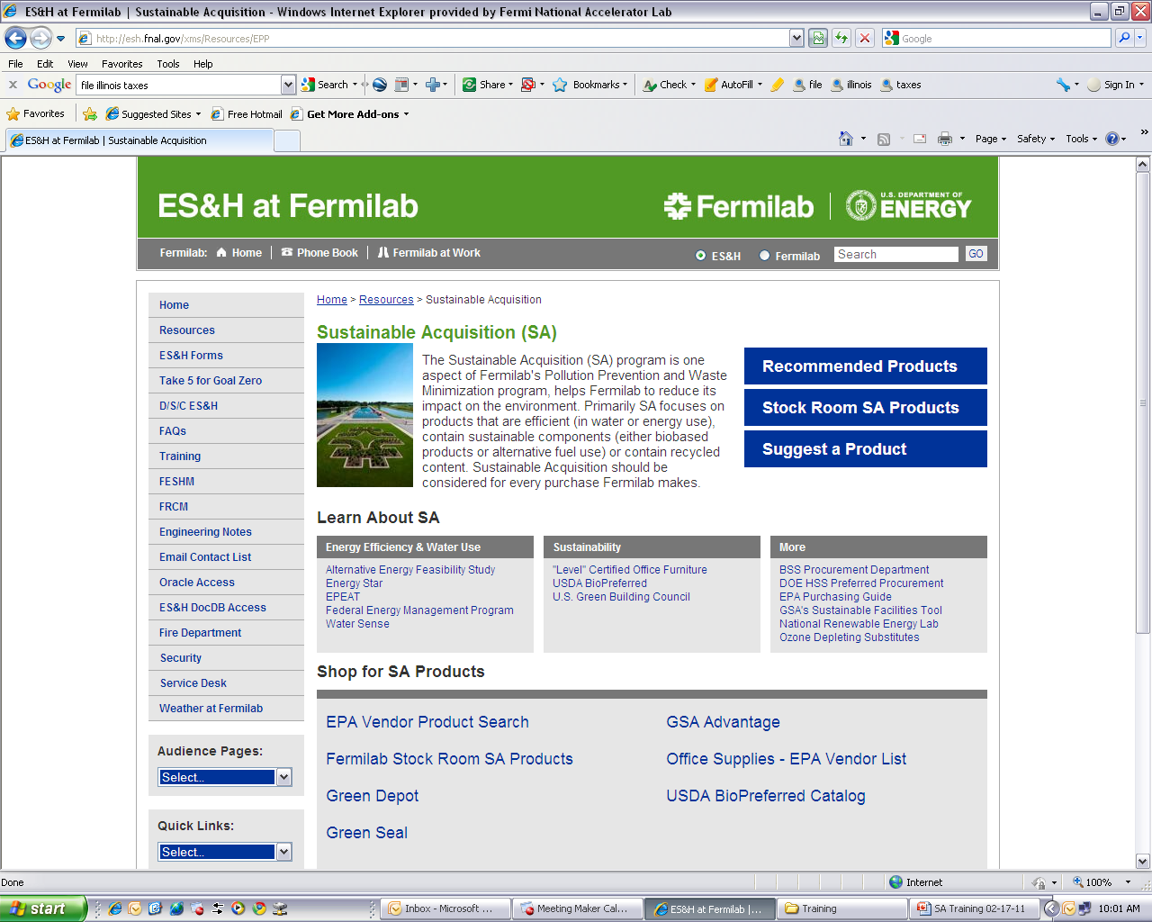
Resources – ES&H Section SA Page
The SA webpage links to many helpful SA resources.
http://esh.fnal.gov/xms/Resources/EPP
Notes:
The ES&H at Fermilab Sustainable Acquisition page provides a number of resources for purchasing environmentally preferable products. This is meant to be a starting point for employees.

Slide 29
Resources – ES&H Section SA Page
The SA webpage links to many helpful SA resources.
Link to Recommended Products
Notes:
The top blue box simply links to a spreadsheet that we developed of recommended products.

Slide 30
Resources – ES&H Section SA Page
The SA webpage links to many helpful SA resources.
Bristols (file folders, etc.) | Carpet | Cement/Concrete
Engine Lubricating Oil | Furniture | Industrial Drums
Landscaping Timbers | Paint | Paper
Park Benches/Picnic Tables | Plastic Trash Bags | Retread Tires
Signage | Tissue Products | Toner Cartridges
Traffic Barricades
Notes:
We looked at the products that DOE asks us to report on every year, and tried to find sources or suppliers for each product.

Slide 31
Office Products
Product Category | Product | Sustainable Qualities | Vendor | Links
Bristols | File folders (manila and colored) | 30% postconsumer fiber | Ability One | http://www.abilityone.com/OA_HTML/ibeCCtpSctDspRte.jsp?section=10044&sitex=10020:22372:US
 | Dyed filing products | 20-50% recovered fiber, including 20% postconsumer fiber | Ability One | http://www.abilityone.com/OA_HTML/ibeCCtpSctDspRte.jsp?section=10044&sitex=10020:22372:US
 | Cards (e.g., index) | 50% recovered fiber, including 20% postconsumer fiber | Roaring Springs | http://www.rspaperproducts.com/
 | Pressboard report covers and binders | 50% recovered fiber, including 20% postconsumer fiber | ACCO Brands | http://www.acco.com/productdetail.aspx?s=0&pid=W384-14BLA
 | Tags and tickets | 50% recovered fiber, including 20% postconsumer fiber | Zing Green website - contact company for custom signs | http://www.zinggreenproducts.com/
Carpet | Polyester carpet face fiber | 25-100% recovered polyethylene terephthalate, including 25-100% postconsumer content |  | http://yosemite1.epa.gov/oppt/eppstand2.nsf/Pages/DisplayAisle.html?Open&Hardware%20Store&Carpet&Type=4
 | Woven, tufted, or knitted fiber and a backing system | 7% minimum biobased content |  | http://yosemite1.epa.gov/oppt/eppstand2.nsf/Pages/DisplayAisle.html?Open&Hardware%20Store&Carpet&Type=4
Notes:
This is a snip-it from that spreadsheet. You can see we list the DOE product category, then the specific product, the sustainable qualities we’re looking for (from the EPA’s Designated Green Products compiliation). Then the vendor and link to the vendor’s website. For some products, like carpet shown here, we link to the EPA’s vendor list and employees can find a supplier that way.

Slide 32
Resources – ES&H Section SA Page
The SA webpage links to many helpful SA resources.
Link to a list of Fermi Stock Room Products.
Notes:
The Fermi stock room provides a number of SA products

Slide 33
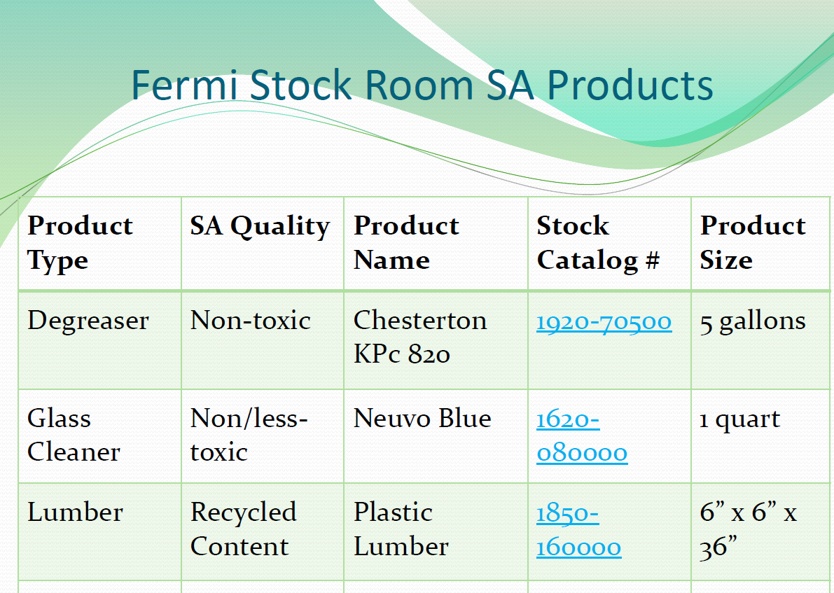
Notes:
We created a similar spreadsheet for the Stock Room products. It describes the products and their SA characteristics along with the stock catalog number and the size of the product. This spreadsheet will be updated as products in the Stock Room are found to meet the SA requirements or as SA versions replace non-SA products.

Slide 34
Resources – ES&H Section SA Page
The SA webpage links to many helpful SA resources.
Send email to suggest a SA product or shopping link that should be added.
Notes:
We also want employee feedback regarding SA. There were only five of us searching for products when we created the Recommended Products list. We want to be able to reap the rewards of potentially 2000 people searching for SA products. So here we provide a link to encourage employees to share their SA finds.

Slide 35
Resources – ES&H Section SA Page
The SA webpage links to many helpful SA resources.
Learn more about SA by clicking the links.
Notes:
This section provides numerous links to learn more about Sustainable Acquisition.

Slide 36
Resources – ES&H Section SA Page
The SA webpage links to many helpful SA resources.
Notes:
You can find information about Energy Star, Water Sense, “level” certified office furniture, DOE’s view on Preferred Procurement, and much more.

Slide 37
Resources – ES&H Section SA Page
The SA webpage links to many helpful SA resources.
Use the links in this section to SHOP for SA products.
Notes:
Along with the “blue” boxes up top, this last segment is probably the most useful. This is the SHOP section.

Slide 38
Resources – ES&H Section SA Page
The SA webpage links to many helpful SA resources.
Notes:
There are links to EPA’s vendor search – one is general and one is specifically for office supplies. There’s also another link to the Stock Room SA list – just to remind people it’s there. The Green Depot and Green Seal websites are awesome tools to find SA products. The GSA Advantage website is also very useful, and has a product search tool where you can select the SA attributes you’re looking for: such as Energy Star, FEMP, EPEAT, recycled content, biobased, etc.
Finally the last link is to the USDA BioPreffered Catalog. As mentioned earlier, it helps find vendors that supply biobased products.

Slide 39
SA Issues
Tracking
  PPTRS (Pollution Prevention Tracking & Reporting System)
    DOE requires reporting on 16 categories (likely to increase)
    USDA requires reporting on ALL biobased categories
    Fermilab’s Oracle procurement program requires major modifications to track these purchases
      No computing support currently available, although there is a proposal for a new procurement program
    Currently purchases are tracked “by hand” by the groups that purchase most frequently – began FY11
ProCard Purchases
Notes:
Although we’ve got a lot of tools at our fingertips, there’s one area we’re still lacking…and that’s tracking what we buy. In order to report to DOE on those 16 product categories and all the biobased product categories we have to be able to track how many dollars are spent on SA and non-SA products.
The system that is currently in place can track for us, but it requires modification. And the modification requires computer scientist expertise that is currently not available.
In the meantime, the groups who primarily purchase the items we report on are keeping track “by hand” in an Excel spreadsheet. This is obviously not ideal. But a new add on to the procurement system called IProcure may solve all of our problems when it arrives.
One other issue is ProCard/credit card purchases. We have yet to tackle this problem.

Slide 40
SA’s future
Fermilab plans to track all purchases
  Including exceptions to SA
    Not cost effective
    Not available in time
    Does not meet performance requirements
The SA webpage will grow as needed
New employees will be trained
Accounting for GHG emissions of vendors/suppliers
Notes:
SA’s future at Fermilab will include a better tracking system one way or another. Hopefully IProcure will do everything we hope. But if not, modifications can be made to improve our reporting quality.
We also plan to let the SA webpage grow as it needs to be most useful to employees.
We will also train all new employees to ensure they buy SA from the get-go.
In the future we will also have to account for our supply chain’s greenhouse gas emissions. GSA along with many other Federal agencies published a study last year that found accounting for supply chain GHGs is feasible. They propose a 2-phase approach beginning in FY11. However, I’m not certain how this is going to play out at DOE facilities, but it will be an exciting challenge to tackle.

